Slide 1
DESIGN AND CONSTRUCTION OF A WIRELESS SENSOR BASED LIGHTING SYSTEM
BEING A REPORT SUBMITTED
BY:
ADESOJI RIDWANLAHI BOLUWATIFE 2018702020035
ADESODUN OLUWASEUN EMMANUEL 2015070202023
ADENIJI TEMITOPE MOSHOOD 2015232070008
ÁDESIYAN KEHINDE ISRAEL 2018702020034

Slide 2
CHAPTER ONE
INTRODUCTION
1.1 Background of the Study
In the future, everything may be ‘connected’ and ‘smart’ in the built environment. The concept of smart lighting has emerged over the past decade in commercial and industrial environments, predominantly focusing on energy saving. From a broader perspective, smart lighting in the residential environment is a part of the ‘smart home’ concept where the main goal is to provide and promote user comfort, convenience, and security, and to satisfy residents’ needs.

Slide 3
In a world where energy conservation and sustainability have become important, the quest for innovative and efficient lighting solutions has gained significant ground. The ever-increasing demand for energy-efficient technologies has spurred the development of sensor-based systems that can intelligently adapt to environmental conditions.
The final year project, titled "Design and Construction of a wireless Sensor-Based Lighting System," delves into the implementation of this technology in energy efficiency to address the pressing need for smart lighting solutions.
What are smart lighting systems?
A Smart lighting system is a series of connected sensors, systes and light bulbs that can detect, sense, Adjust and interact automatically with their environments and with users and other smart devices. Unlike regular light bulbs which require manual operation, smart lights can be Autonomous

Slide 4
1.2 Problem Statement
There are several problems that led to the need for the design of this project. One of which was the lack of automation in switching off and on light switches, which can result in lights being left unnecessarily on, leading to increased energy consumption and higher utility costs, apart from that is the increased energy consumption which contributes to a larger carbo footprint, which can be detrimental to the environment furthermore the problem that lead to the need for the design of a wireless sensor based lighting system is also the problem of Continuous operation of Led at all times even when not necessary. Adopting a wireless sensor-based lighting system can address these issues by providing a more intelligent and responsive approach to lighting control, ultimately leading to energy savings, increased efficiency, and improved occupant comfort.

Slide 5
1.3 Aim and Objectives
The Aim of the project is to Build an intelligent wireless based sensor lighting system that uses sensor technologies to control lighting system of a building or structure to dynamically
The following objectives to achieve this aim are itemized below:
• Design a wireless sensor-based lighting system that dynamically adjusts brightness based on real-time data, minimizing energy wastage and enhancing efficiency.
• Integrate a range of sensors such as motion detectors and occupancy sensors to enable real-time environmental monitoring.
• Design an algorithm that dynamically adjust illumination levels based on data received from the wireless sensors, optimizing energy efficiency while maintaining user comfort.

Slide 6
1.4 Significant of the Study
Wireless sensor-based lighting system holds significant importance due to several advantages and benefits it brings to various aspects of lighting management, energy efficiency, and overall building performance. Wireless sensor-based lighting systems enables intelligent control by adjusting lighting levels based on occupancy & ambient light conditions.
This leads to significant energy savings by avoiding unnecessary illumination in unoccupied or well-lit areas, Reduced energy consumption directly translates to lower utility costs, making wireless sensor-based lighting systems a cost-effective solution in the long run.

Slide 7
1.5 Methodology
The microcontroller starts and sends a start signal to all connected components to it, thereafter it sends a read signal to the PIR sensor module to Detect there is change in the environment or if a person has entered in to the premises. If the PIR motion sensor returns a high signal to mean that a person has entered the room, trigger the microcontroller to verify in the intensity of light needed in the room, to verify such the microcontroller send a read signal to the LDR module to checks the level of brightness / darkness of the room and calculates the needed amount of light that is needed in that environment leading the system to turn on the lighting system based on the light intensity value returned by the LDR Module.

Slide 8
Major Components Used For Design Of System
AC-DC Module
Microcontroller (Arduino Nano / ATMEG)
PIR Motion sensor
Light Dependent Resistor
Power Supply Module
Light Emitting Diode
Relay Module

Slide 9
1.6 Scope and Limitation of the Study
Scope:
• Designing for optimal energy consumption through intelligent control of lighting based on occupancy and ambient light conditions.
• Implementing sensors to detect the presence or absence of occupants in a space.
• Designing systems that dynamically adjust lighting intensity, color, and distribution.
Limitations:
• Regular maintenance may be required, and sensors may have a limited lifespan.
• Challenges in scaling the system to larger or more complex installations.
• Accuracy challenges in occupancy detection, leading to false positives or negatives

Slide 10
CHAPTER TWO
LITERATURE REVIEW
2.1 Introduction
The project draws inspiration from previous research on occupancy sensing and adaptive lighting control Studies by Rea et al. (2013) which highlights the significance of adaptive lighting systems and the need for The inclusion of occupancy sensors in the wireless sensor-based lighting system

Slide 11
2.2 Preview of The Related Work
Soyoung Hwang et al. developed a remote monitoring and controlling system which is based on zigbee networks. Real time monitoring is implemented with JMF. It is a multimedia extension API of java. (Soyoung Hwang and Donghui Yu, 2012)
Richu Sam Alex et al designed and constructed a system which reduced the power consumption of the street lighting system about 30% compared to conventional design. This system is fully automated. It also uses Zigbee so that control station can also analyze all the performances of the system (Richu Sam Alex, R NarcissStarbell, 2014).
Daeho Kim et al. worked on smart LED lighting system by using Infrared and Ultrasonic sensors together. Here they proposed a model which continuously tracks the human motion. Output based on the human tracking data which is obtained by these sensors are responsible for determining the On-Off control of the LED lighting ( Daeho Kim, Junghoon Lee, Yeongmin Jang and Jaesang Cha, 2010).

Slide 12
2.2 Preview of The Related Work
Previously existing system failed in continuously monitoring the motion of an object by using each sensor separately. For the same reason, the efficiency of the existing system is low. By the hardware implementation they developed a model to improve the efficiency which helps in smart lighting. The proposed approach make use of sensors in which IR sensor sends the sensed data to the MCU board which in turn sends the same data to the LED control layer. Depending on the results of the sensed data LED control layer turns on the lighting system

Slide 13
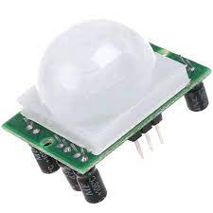
CHAPTER THREE
METHODOLOGY
3.1 Introduction
The implementation process involves not only the installation of hardware components but also the development of user-friendly interfaces, allowing occupants and facility managers to interact with and customize the lighting environment. This approach aims to ensure that the technology is not only efficient but also intuitive, fostering user acceptance and engagement. As the methodology unfolds, it will delve into of wireless sensor-based lighting solutions in various building systems.
3.2 Design Analysis
3.2.1 PIR Motion sensor: A PIR (Passive Infrared) motion sensor is a type of electronic sensor that detects motion by measuring changes in infrared radiation levels in its field of view.
Figure 3.1:
PIR Motion Sensor

Slide 14
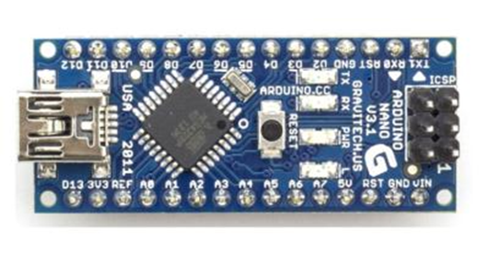
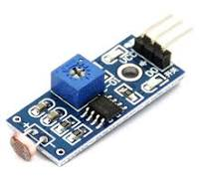
3.2.2 Arduino Nano: is an open-source electronics platform based on easy-to-use hardware and software. It consists of a microcontroller board and the Arduino IDE (Integrated Development Environment).
Figure 3.2. Arduino Nano
3.2.3 Light Dependent Resistor: A Light Dependent Resistor (LDR), also known as a photo resistor, is a type of resistor whose resistance changes with the intensity of incident light. LDRs are widely used in various applications where light levels need to be sensed or controlled.
Figure 3.3. LDR Module

Slide 15
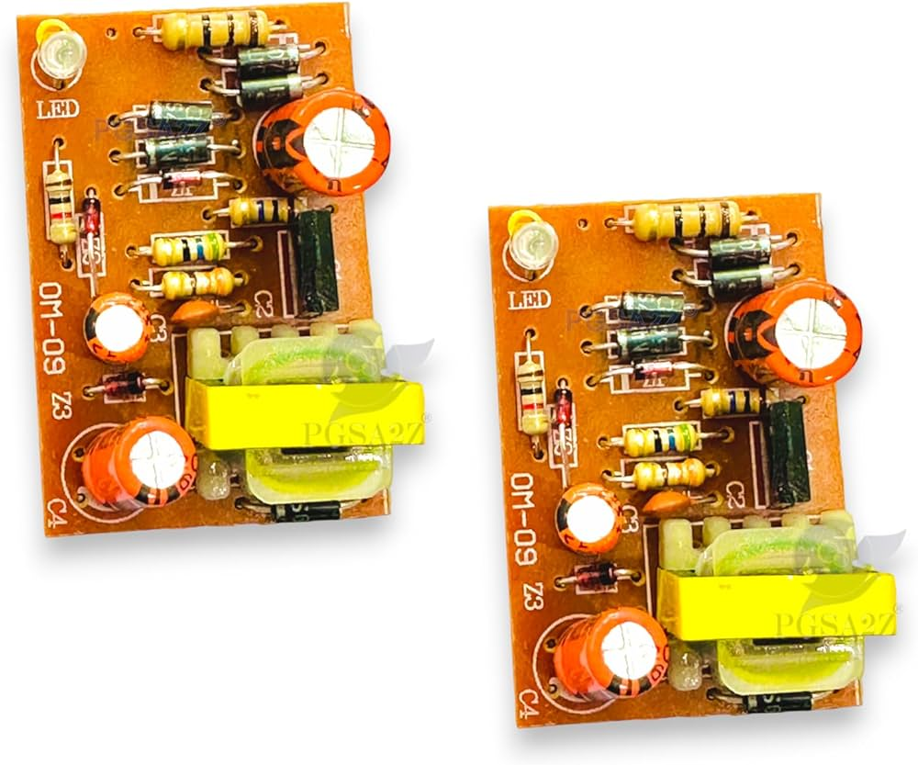
3.2.4 Power Supply Module: it convert 220V AC to 12V DC to enable the system to use less power but produce same or even more functionality, you can use a bridge rectifier along with a capacitor filter to smooth the rectified output. Additionally, a voltage regulator to stabilize the output voltage is used.
Figure 3.4 12V Power Supply Module

Slide 16
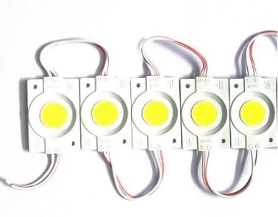
3.2.6 Light Emitting Diode: Light Emitting Diodes (LEDs) are semiconductor devices that emit light when an electric current pass through them. LEDs can be equipped with smart features such as color-changing capabilities, remote control, and connectivity to smart devices. These advanced features enhance the overall functionality and user experience of a smart lighting system.
Figure 3.5 Light Emitting Diode

Slide 17
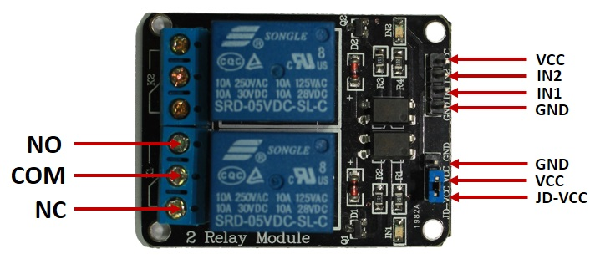
3.2.7 Relay Module: A relay module is an electrical device that consists of a relay and associated components mounted on a circuit board. It is commonly used in electronics and automation projects to control high-power electrical devices with low-power microcontrollers or other digital circuits. The relay module acts as an interface between the low-voltage control circuit and the higher-voltage load circuit.
Figure 3.6 Relay Module

Slide 18

3.3 Block Diagram of Wireless sensor Based lighting system

Slide 19
Detection Unit: The detection unit of the smart sensor-based lighting system detects the presence of individual using a three PIR motion sensor that each cover 120 degrees making a total of 360 degrees covered. It does not send any message to the control unit unless motion is detected again, in the case in which motion is detected again it send a motion detected signal to the control circuit using its transmitter (CC1101) set at a frequency of 433.49Mhz to turn on the lighting systems and to remain on for a minute unless a fresh signal is sent again.

Slide 20
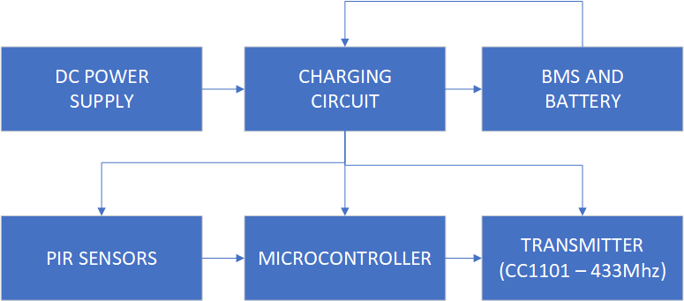
Block Diagram of Wireless sensor Based lighting system – Detection unit

Slide 21
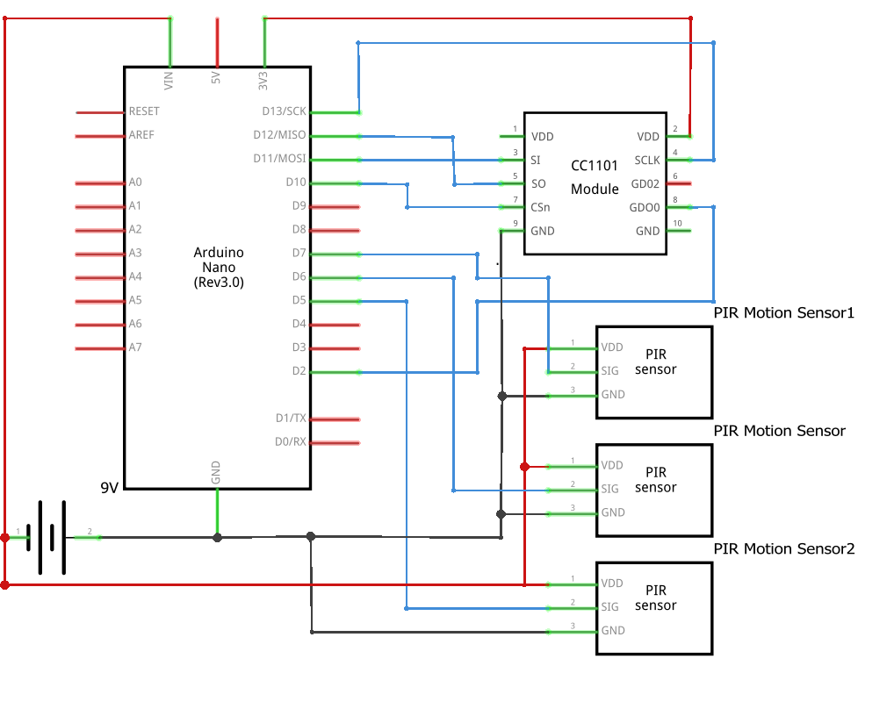
Circuit Diagram of Wireless sensor Based lighting system – Detection unit

Slide 22
Control Unit:
The detection unit detects the presence of individual using a PIR motion sensor and sends a message to the control unit using a transmitter (CC1101) set at a frequency of 433.49Mhz.

Slide 23
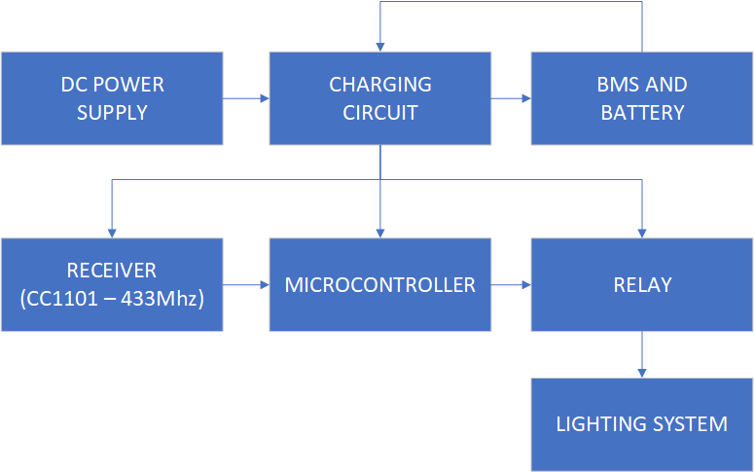
Block Diagram of Wireless sensor Based lighting system – Control unit

Slide 24
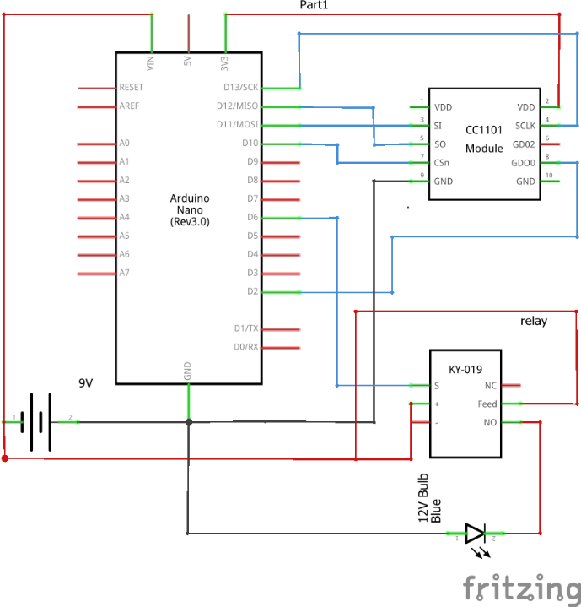
Circuit Diagram of Wireless sensor Based lighting system – Control unit

Slide 25
CHAPTER FOUR
RESULTS AND DISCUSSION
4.1 Observation: The Wireless Sensor based lighting system was evaluated based on several performance metrics, including sensor accuracy, Transmission distance, relay response time and overall reliability.
4.2 Transmission Unit: The detection unit consists of four major component’s such as PIR motion sensor, microcontroller, CC1101 transmitter and battery management system we would be testing all.

Slide 26
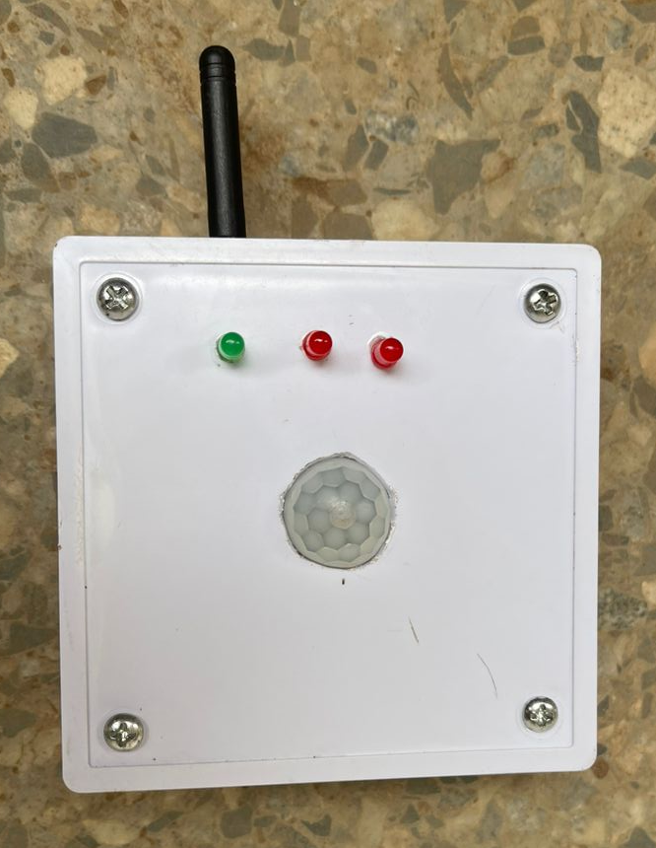
Detection Unit or
Transmitter Unit
1. PIR Sensor Accuracy
The PIR motion sensors demonstrated high accuracy in detecting motion within a range of 5 to 20 cm. The sensors responded well to movements, with a detection rate of over 95% during tests. Testing indicated a low incidence of false positives and negatives. Adjustments in sensor positioning and sensitivity thresholds further reduced errors detected.

Slide 27
Detection Unit or
Transmitter Unit
2.Transmitter Accuracy
The CC1101(433Mhz) transmission range was tested to see how far the device was able to transmit without signal loss, after testing it was seen that it could transmit accurately between 1 – 5 meters from the receiver enabling it to be used in long distance cases.

Slide 28
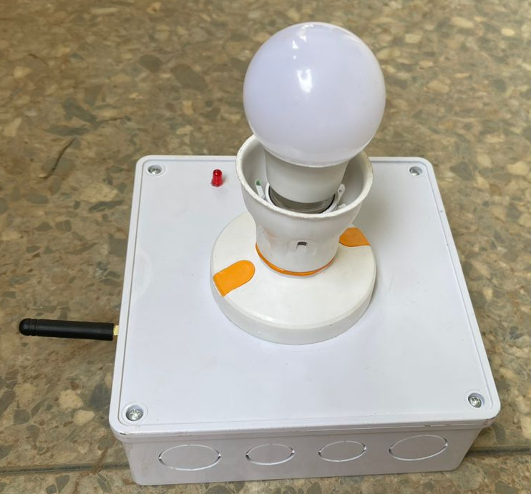
4.2 Control and Receiver unit: The Control unit is the part of the wireless sensor-based lighting system that controls the lights, it receives the signal and decides when to switch on and off the light. It major components include a microcontroller, CC1101 receiver, Relay Module, power supply and battery management system.

Slide 29
Receiver / Control Unit
1. Receivers Accuracy: The CC1101(433Mhz) transmission range was tested to see how far the device was able to continuously receive signal loss, after testing it was seen that it could continuously and accurately receive complete data between 5-10 meters from the transmitter enabling it to be used in long distance cases. Also, the CC1101 receiver can achieve high accuracy and reliability over a distance of 5 meters, particularly in environments with minimal interference and proper

Slide 30
Detection Unit or
Transmitter Unit
2.Transmitter Accuracy
The CC1101(433Mhz) transmission range was tested to see how far the device was able to transmit without signal loss, after testing it was seen that it could transmit accurately between 1 – 5 meters from the receiver enabling it to be used in long distance cases.

Slide 31
CHAPTER FIVE
CONCLUSION
The Sensor-Based Lighting System project has successfully demonstrated the potential of integrating modern sensor technologies into lighting solutions. This project set out to design and implement an intelligent lighting system capable of optimizing energy usage, enhancing user convenience, and providing operational flexibility wirelessly. One of the primary achievements of this project was the design and integration of various sensors with lighting control modules. By incorporating motion sensors, the system could dynamically adjust lighting based on real-time environmental conditions. This means that lights were only activated when movement was detected

Slide 32
CHAPTER FIVE
RECOMMENDATION
The integration of more advanced sensor technologies is an important step forward. By incorporating infrared sensors, ultrasonic sensors, and even cameras with image recognition capabilities, the system can achieve more precise occupancy detection and further optimize lighting control, especially in complex environments.

Slide 33
Another important recommendation is to implement user customization features through a mobile app or web interface. This would allow users to tailor the lighting system to their specific preferences and schedules, enhancing user satisfaction and engagement. Additionally, integrating the system with existing smart home ecosystems, such as Google Home, Amazon Alexa, or Apple HomeKit, would significantly improve its usability and appeal to a broader audience. This seamless integration would make the lighting system a more attractive option for users already invested in smart home technologies.

Slide 34
REFERENCES
1. Rubinstein, F., Xiaolei, D., & Watson, D. (2010). Using Dimmable Lighting and Occupancy Sensors to Reduce Energy Use in Office Lighting Systems. Lawrence Berkeley National Laboratory.
2. MIT Energy Initiative. (2013). Case Studies in Building Efficiency: MIT Green Building (Building 54). Massachusetts Institute of Technology.
3. Smith, J., & Brown, L. (2005). Development of Wireless Sensor Networks. Journal of Engineering History, 10(3), 123-135.
4. Zigbee Alliance. (2003). Zigbee Specification. Retrieved from Zigbee Alliance.
5. Jung, M., & John, M. (2018). IoT-Based Smart Lighting Systems: A Review. Sensors, 18(8), 2758.
6. Guo, X., & Tiller, D. K. (2016). Machine Learning for Smart Lighting Control. Energy and Buildings, 127, 438-448.
7. Rehman, M. H., & Loo, J. (2019). Energy-Harvesting Wireless Sensor Networks: Sustainable Design and Applications. IEEE Communications Surveys & Tutorials, 21(4), 2555-2590.
8. Soyoung Hwang and Donghui Yu, “Remote Monitoring and Controlling System Based on Zigbee Networks” International Journal of Software Engineering and Its Applications Vol. 6, No. 3, July,2012.

Slide 35
THANK YOU
FOR YOU
ATTENTION

